Slide 1
Apache Spark vs MapReduce

Slide 2
Apache Spark
Distributed computing framework (we will run it on YARN)
API in several languages: Scala, Java, Python (PySpark)
Includes a lot of stuff: Spark ML, Spark SQL, Spark Streaming, etc.
http://spark.apache.org

Slide 3
SQL join query
Table a – purchases (user, product, …)
Table b – contact info (user, country, …)
We want to know the country where each purchase took place.
We need to join these tables on user:
select a.product, b.country
from
a join b on a.user = b.user

Slide 4
SQL join on MapReduce
a
b

Slide 5
One more join on MapReduce
Table c contains product info (product, category, …)
First join on MapReduce:
MR job
a
a join b
join on user
b
(product, country)

Slide 6
One more join on MapReduce
Table c contains product info (product, category, …)
Second join on MapReduce:
MR job
a
a join b
MR job
join on user
join on product
result
b
c
(product, country)
(category, country)

Slide 7
One more join on MapReduce
Table c contains product info (product, category, …)
Two joins on MapReduce:
MapReduce results are stored in HDFS
So, for “a join b” we spend time on writing to HDFS and reading it back
MR job
a
a join b
MR job
join on user
join on product
result
b
c
(product, country)
(category, country)

Slide 8
That’s where Spark shines
Two joins on Spark:
Computation is described as a DAG (Directed Acyclical Graph)
Intermediate results can be cached in memory or on disk, skipping HDFS
Spark job
a
join on user
join on product
result
b
(product, country)
c
(category, country)

Slide 9
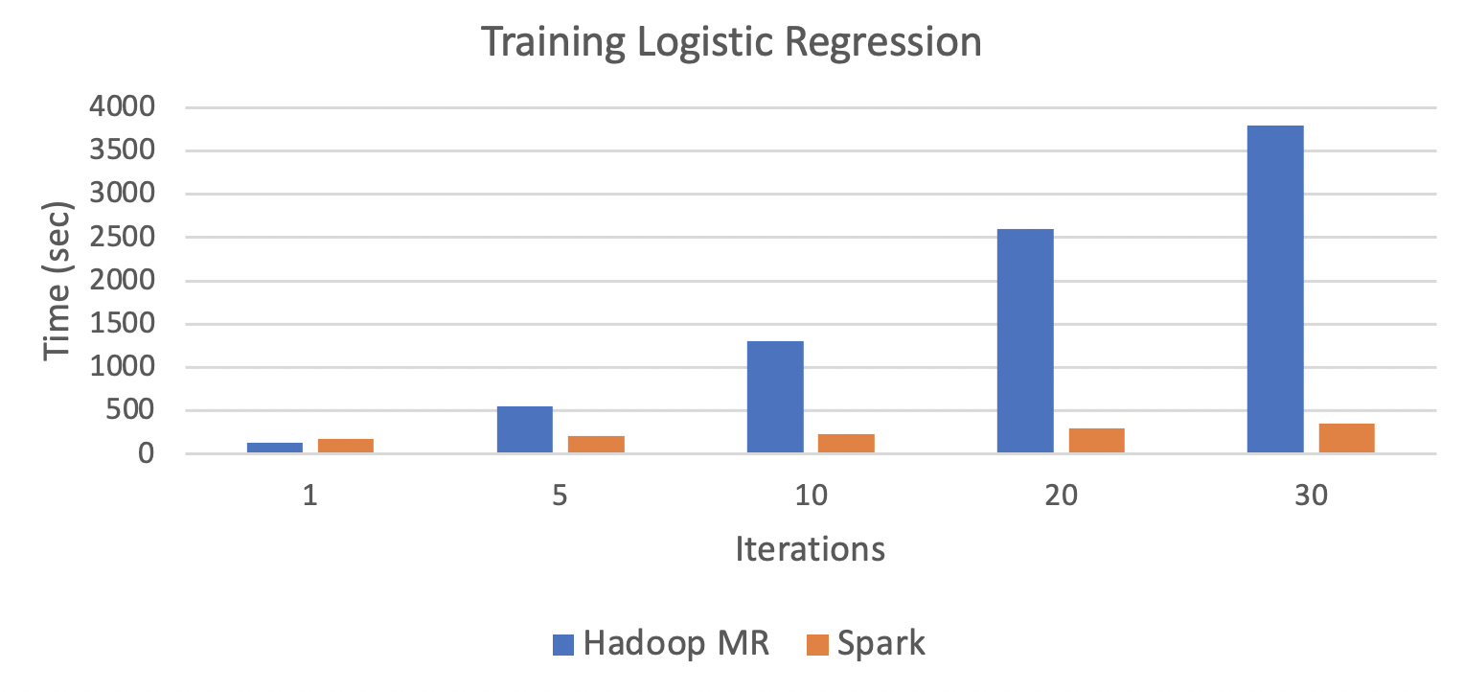
Iterative algorithms
MapReduce has overheads:
Reading and writing to/from HDFS
Starting up each MR job on YARN cluster (scheduling, starting JVM, etc.)
In ML we have lots of iterative algorithms and Spark works best on them:
https://www.edureka.co/blog/apache-spark-vs-hadoop-mapreduce

Slide 10
Spark vs MapReduce
 | Spark | MapReduce
Usage | Iterative and interactive computation | Heavy load offline processing
Simplicity | Python API | Hadoop text-based streaming
Storage | Utilizes RAM for cache | Everything is stored in HDFS

Slide 11
Spark RDD API

Slide 12
Spark RDD
Spark program is a set of operations on RDDs
Abstract RDD – resilient distributed dataset:
Job inputs and outputs are RDDs
All intermediate results are RDDs as well (you know the DAG and can restore missing parts if you lose them)
https://spark.apache.org/docs/latest/rdd-programming-guide.html

Slide 13
Spark RDD
Spark program is a set of operations on RDDs
Abstract RDD – resilient distributed dataset:
Job inputs and outputs are RDDs
All intermediate results are RDDs as well (you know the DAG and can restore missing parts if you lose them)
How to make an RDD:
A file from HDFS (already resilient and distributed)
Parallelize a Python collection (list, generator, …)
Transform another RDD
https://spark.apache.org/docs/latest/rdd-programming-guide.html

Slide 14
RDD operations
Transformations (RDD → RDD):
Transformation is lazy (i.e. computed when it’s needed)
Example: map is a transformation that passes each dataset element through a function and returns a new RDD representing the results
Other examples: reduceByKey, join

Slide 15
RDD operations
Transformations (RDD → RDD):
Transformation is lazy (i.e. computed when it’s needed)
Example: map is a transformation that passes each dataset element through a function and returns a new RDD representing the results
Other examples: reduceByKey, join
Actions:
Action triggers DAG execution to compute RDD
Examples: saveAsTextFile, collect, count

Slide 16
RDD operations
Transformations (RDD → RDD):
Transformation is lazy (i.e. computed when it’s needed)
Example: map is a transformation that passes each dataset element through a function and returns a new RDD representing the results
Other examples: reduceByKey, join
Actions:
Action triggers DAG execution to compute RDD
Examples: saveAsTextFile, collect, count
Other operations:
Example: persist, cache will force Spark to keep the RDD in memory for much faster access the next time you query it

Slide 17

How PySpark program works (yarn cluster mode)
You create SparkContext in Python to communicate with Spark cluster.
Client
Spark Context

Slide 18
How PySpark program works (yarn cluster mode)
You create SparkContext in Python to communicate with Spark cluster.
YARN application is started, running driver as Application Master, which creates JVM version of SparkContext (stores configuration, DAGs for all RDDs, etc.).
Client
Application Master
JVM driver
Spark Context
Py4J
Spark Context

Slide 19
How PySpark program works (yarn cluster mode)
You create SparkContext in Python to communicate with Spark cluster.
YARN application is started, running driver as Application Master, which creates JVM version of SparkContext (stores configuration, DAGs for all RDDs, etc.).
Driver coordinates the work of Executors (making actual computation).
Client
Application Master
JVM driver
JVM executor
Spark Context
Py4J
Spark Context
JVM executor
YARN containers

Slide 20
How PySpark program works (yarn cluster mode)
Python objects are serialized with pickle and need deserialization to be processed
Which means objects are stored twice in memory:
Serialized in worker JVM (e.g. cached RDD)
Deserialized object in Python process
Client
Application Master
JVM driver
JVM executor
pickle
Python executor
Spark Context
Py4J
Spark Context
JVM executor
pickle
Python executor
YARN containers

Slide 21
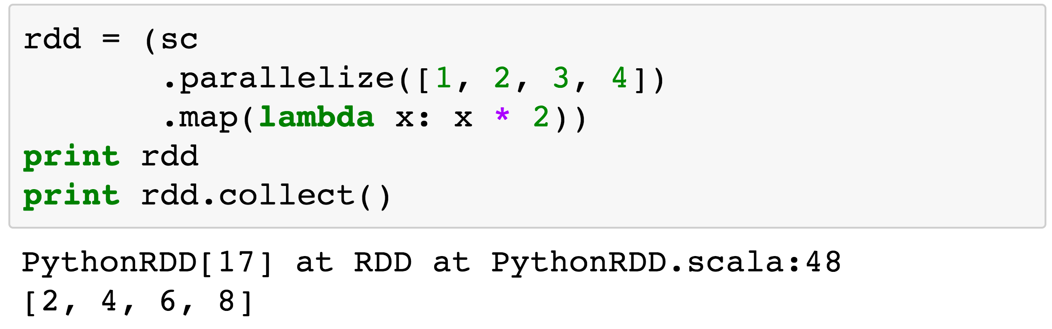
PySpark code example
# SparkContext
# make RDD
# transform RDD
# lazy DAG
# run DAG

Slide 22
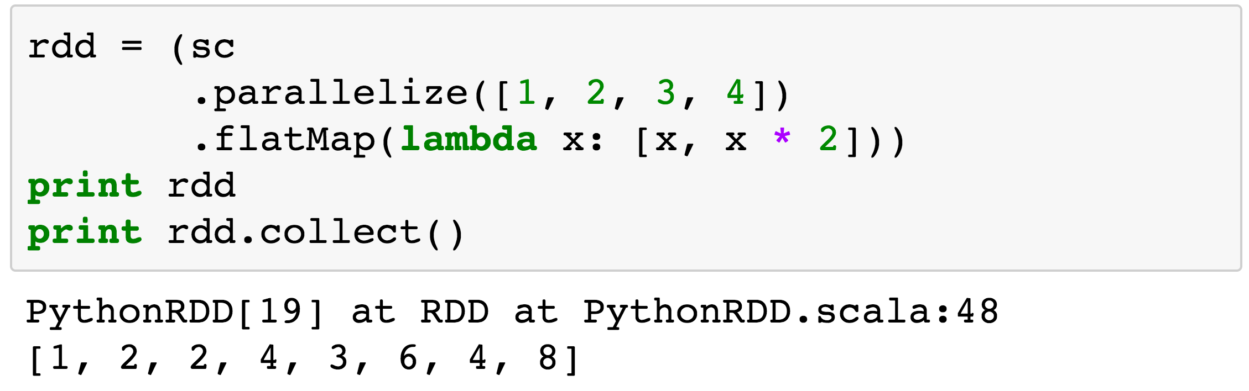
One more transformation example

Slide 23
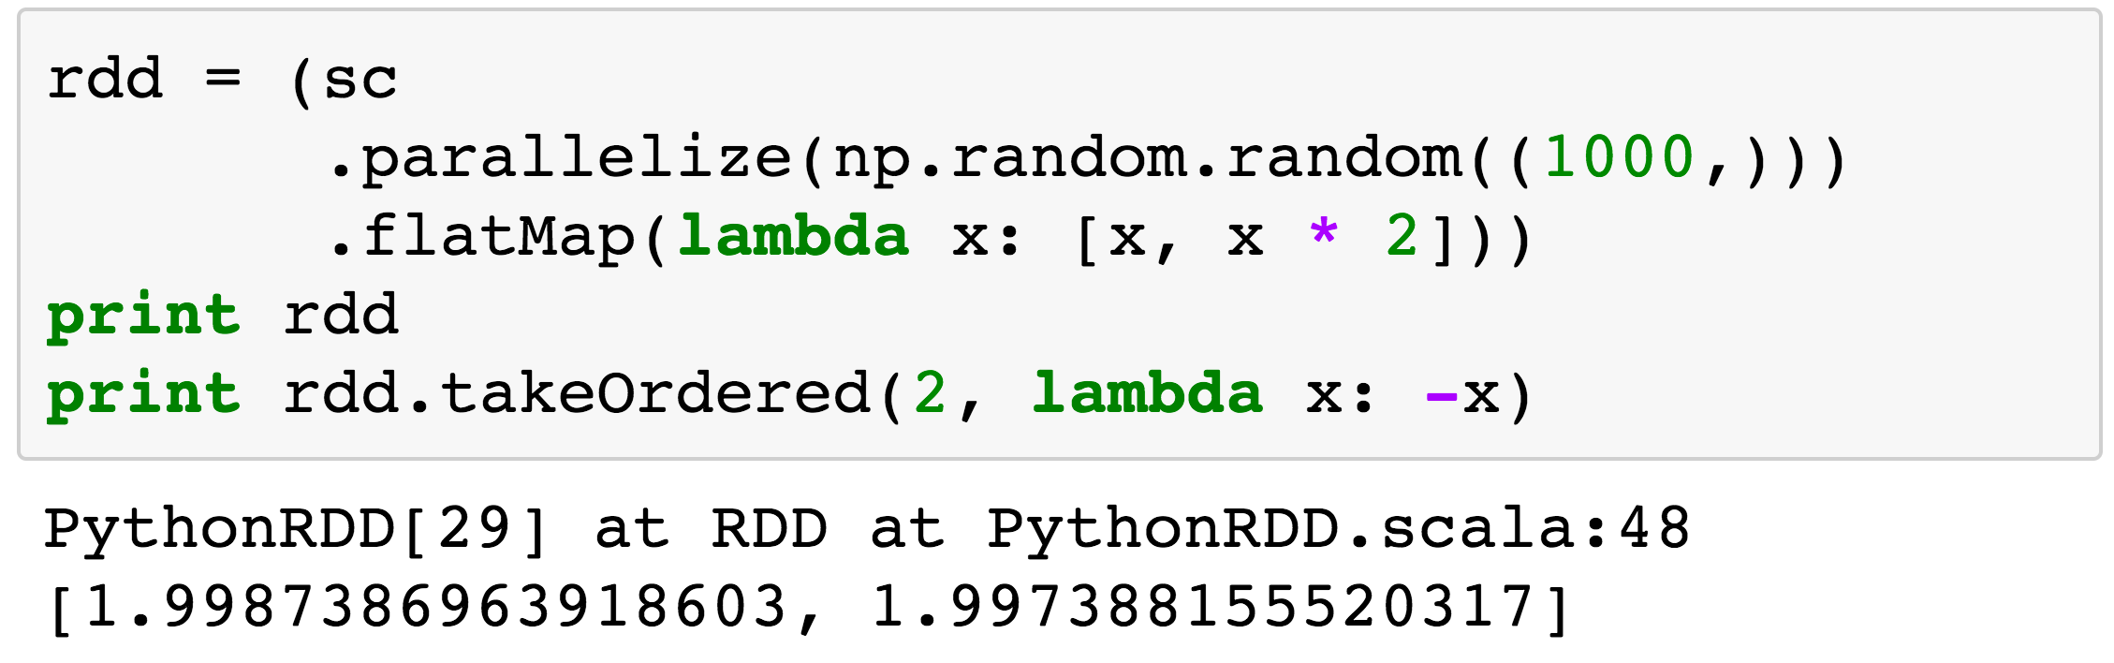
One more action example

Slide 24
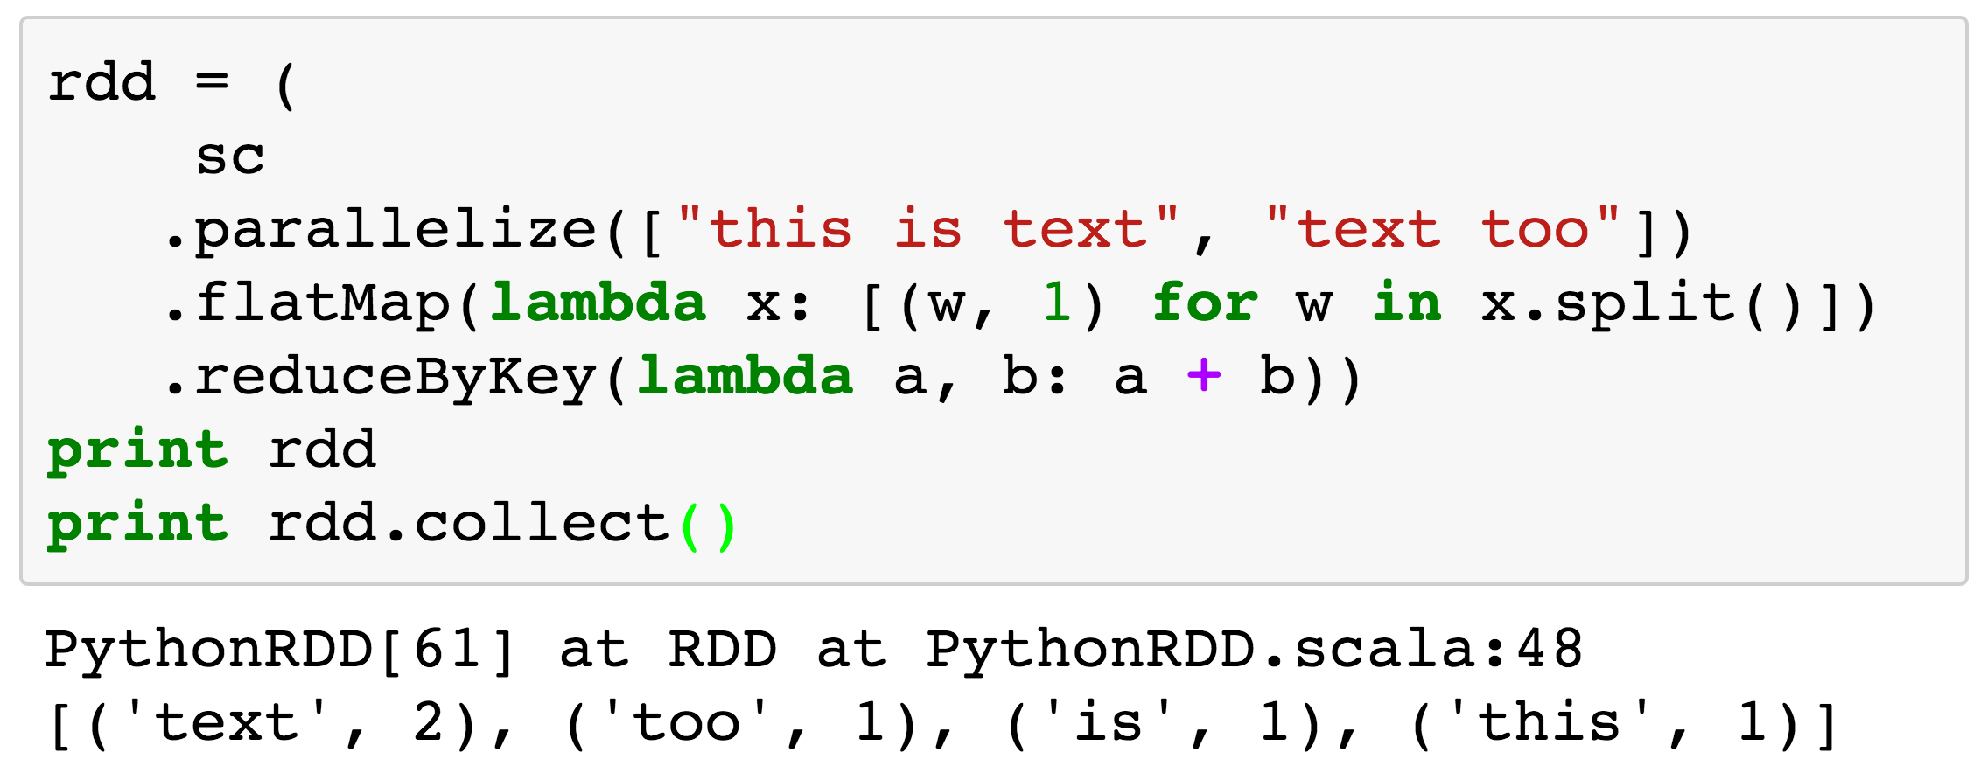
Word Count in Spark

Slide 25
Spark quiz
Notes:
Q: What is the output of the following code?
- [(100, 1)]
- [(10, 99)]
- [(99, 100)]
- [(10, 10)]

Slide 26
Spark quiz
[(10, 99)]
Notes:
Q: What is the output of the following code?
- [(100, 1)]
- [(10, 99)]
- [(99, 100)]
- [(10, 10)]

Slide 27
Caching in RAM
lines = sc.textFile("...", 4)
print lines.count()
lines
count() causes Spark to:
read data
sum within partitions
combine sums in driver
#
#
#
#

Slide 28
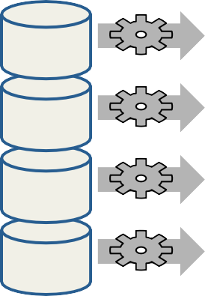
Caching in RAM
lines = sc.textFile("...", 4) comments = lines.filter(isComment) print lines.count(), comments.count()
lines
comments
Spark recomputes lines:
read data (again)
sum within partitions
combine sums in driver
#
#
#
#
#
#
#
#

Slide 29
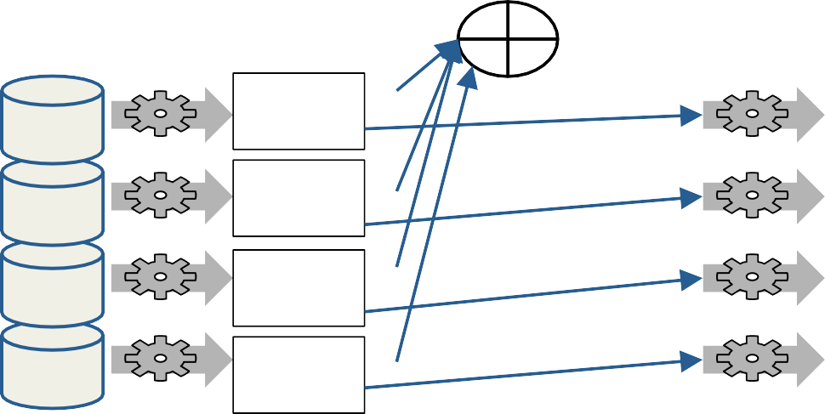
Caching in RAM
lines = sc.textFile("...", 4)
lines.cache() # save, don't recompute!
comments = lines.filter(isComment) print lines.count(),comments.count()
lines
comments
#
#
#
#
RAM
#
RAM
#
RAM #
RAM
#

Slide 30
Conclusion
Spark is easier to use than MapReduce
Very flexible due to pickle serialization (works with virtually any Python object)
But not as fast as Scala/Java version (you can compensate with more nodes)

